Slide 1


Group 6
Sameer Barretto
Brayan Alfonso
Aayush Shah
Rory Dunne
Anirudh Sharma

Slide 2

Apprisen challenge statement:
How can Apprisen help Debt Management Program participants successfully graduate from the program at a higher rate?.

Slide 3
OUR GOAL
Create an app that satisfies our Nonprofit Organization needs, by including features such as:
Debt Tracker(Balance, Payment, Interest Rate, Estimate time to completition)
Budget (Income)
Payment Reminders (Push/Email/Text/Phones)
Nest egg tracker(Savings Account)
Appointment Scheduling
Find nearby locations

Slide 4
HOW DOES OUR PROPOSED SOLUTION RESPOND TO THE CHALLENGE STATEMENT?

Slide 5
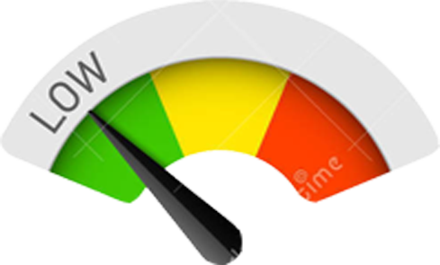
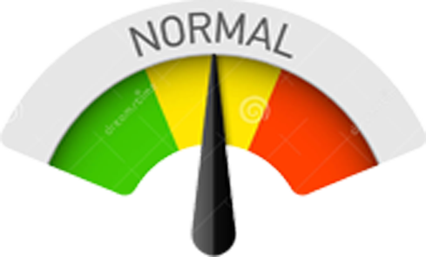
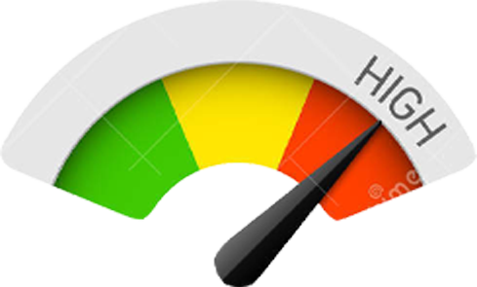


Balance Summary
See how your Credit Score has risen
Color for levels of accomplishment:

Slide 6


MOTIVATIONAL VISUAL REPRESENTATION
Missed Payment ?
Get back on track!
Do you want to talk to someone?
*** All about motivation ***

Slide 7
We used Flutter:
Google’s UI toolkit for building beautiful, natively compiled applications for mobile, web, and desktop from a single codebase.

Slide 8

We used Flutter:
Google’s UI toolkit for building beautiful, natively compiled applications for mobile, web, and desktop from a single codebase.

Slide 9
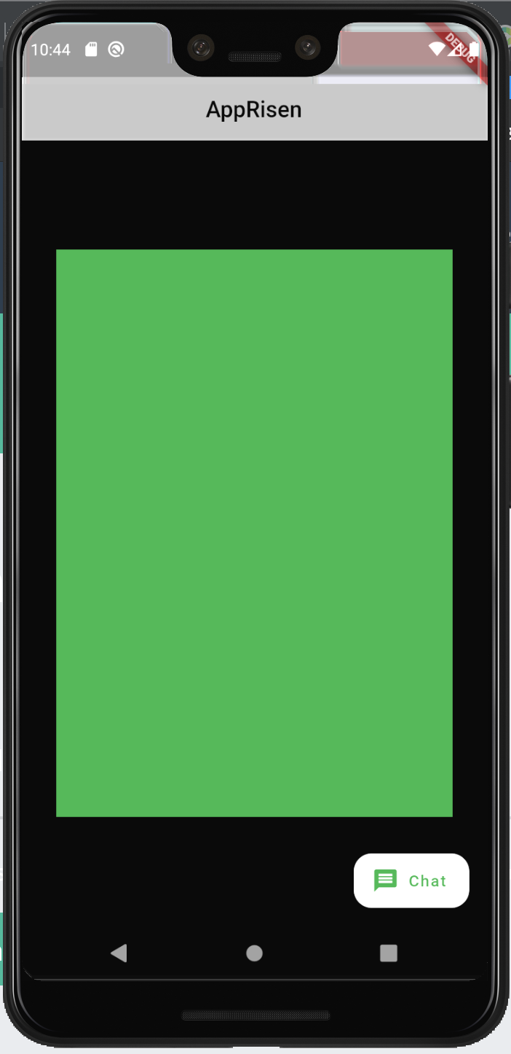
What we developed:

Slide 10
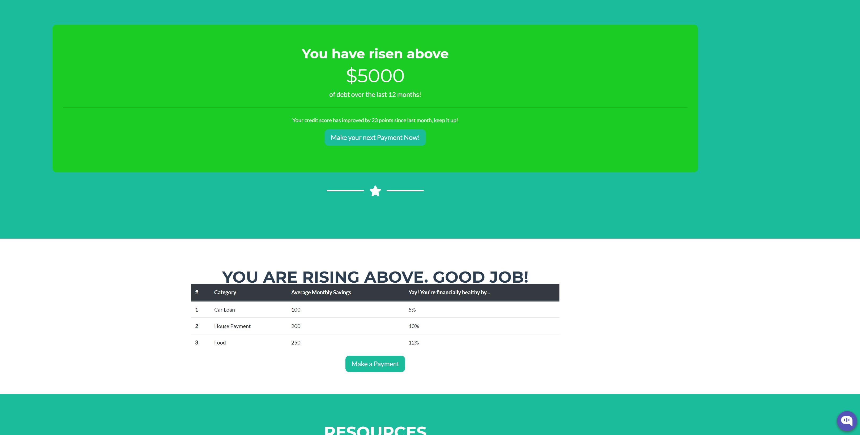

Slide 11
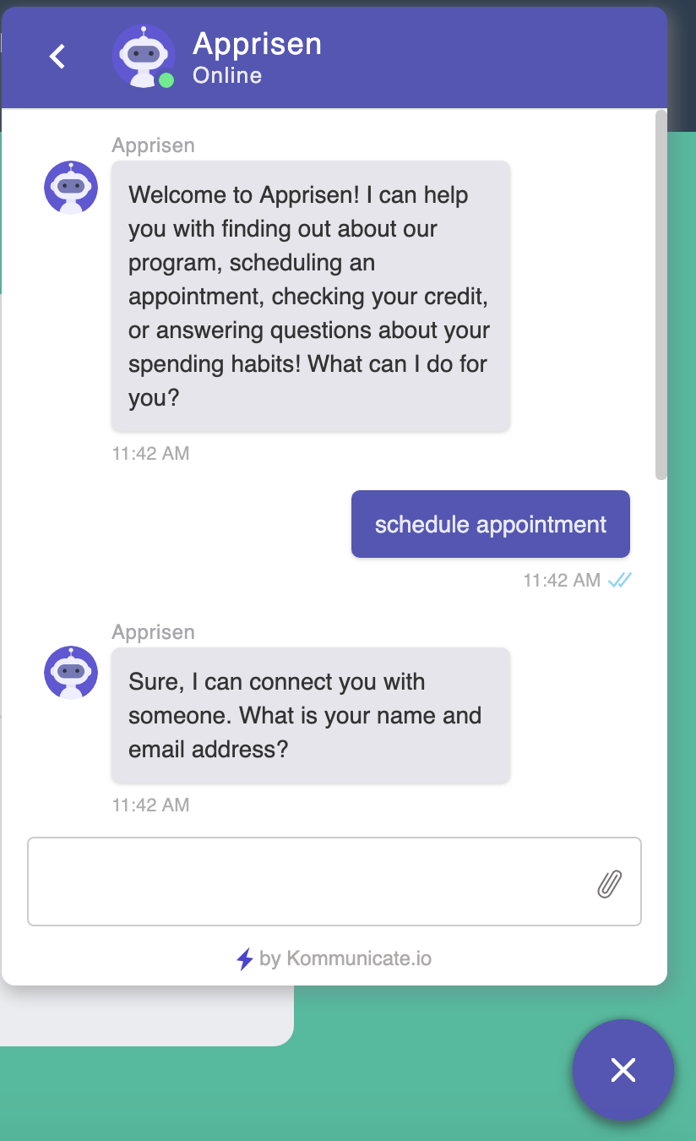
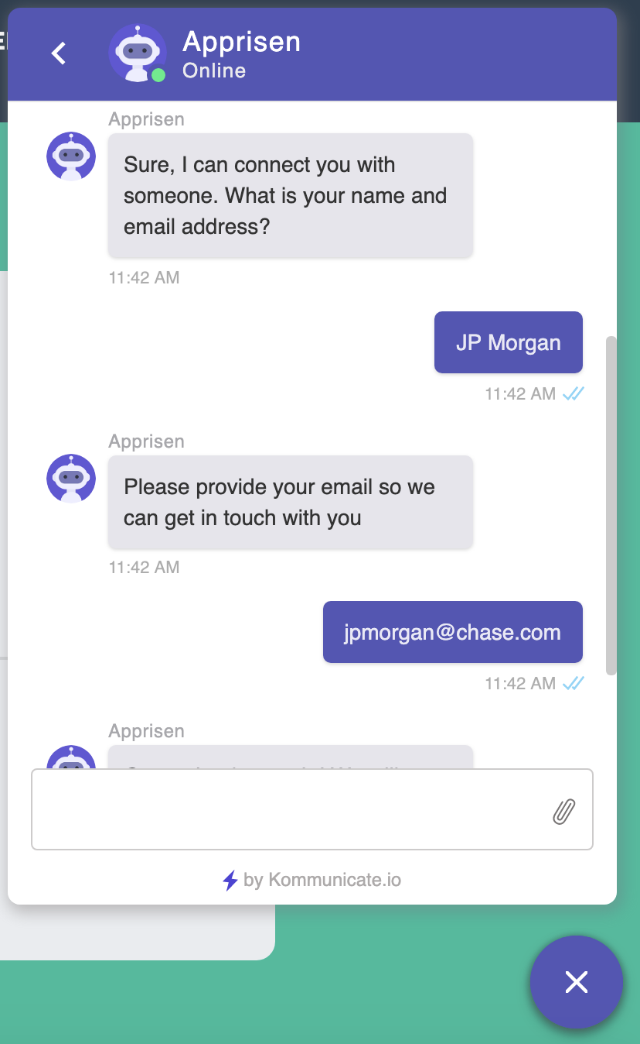
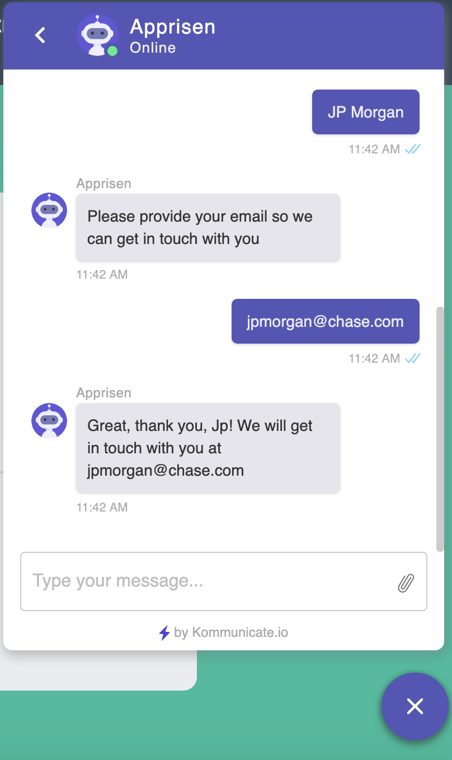

Slide 12
OUR VISION

